Slide 1
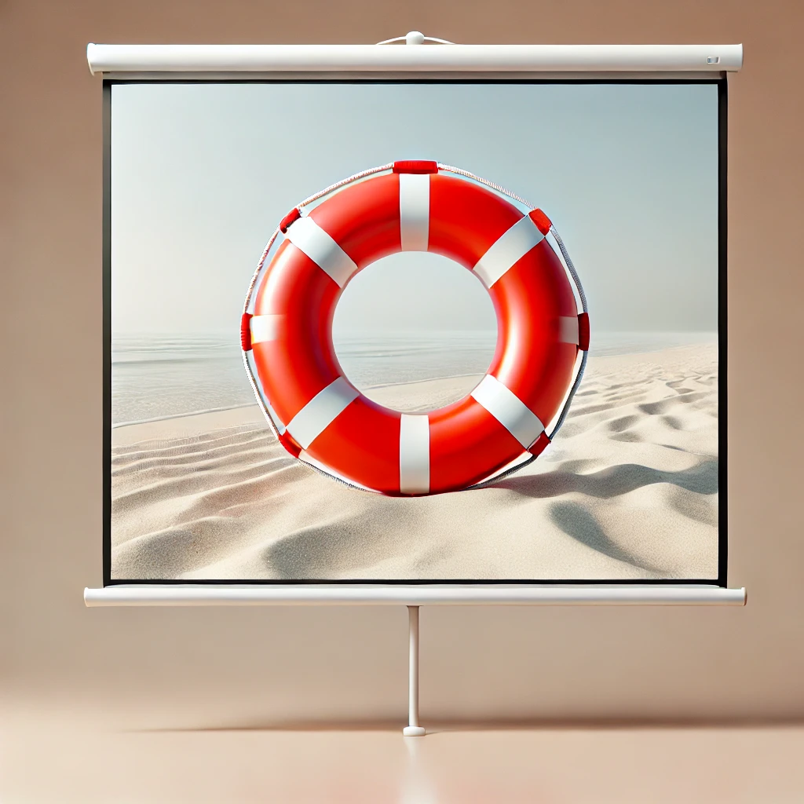
Lifeguard Response Strategies: Analyzing Shark Attack Trends in Florida Prepared by: Nancy, Aru, Benoit, Diego

Slide 2

Shark Attacks in Florida: A Growing Concern
• Higher incidence of shark attacks
• Serious consequences for public safety
• Lifeguards face mounting challenges
Our goal: Provide insights to help lifeguards maximize efficiency, optimize protocols, and stay prepared

Slide 3

Florida Lifeguards’ Checklist:
• Be where it counts when it matters:
Strategically positioned to respond at the right moment
• Focus on high-risk activities:
Target the most dangerous water activities
• Prepare for every scenario:
Equipped with the right medical supplies for rapid response
• Optimize teams for high-risk areas:
Structure teams where shark attacks are most likely

Slide 4
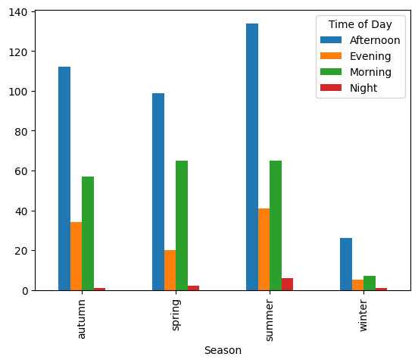
Sharks don’t take summers off!
• Afternoon shark attacks are significantly higher across all seasons, with summer and autumn having the most incidents
• Prioritize lifeguard staffing in the afternoons, especially during summer and autumn

Slide 5
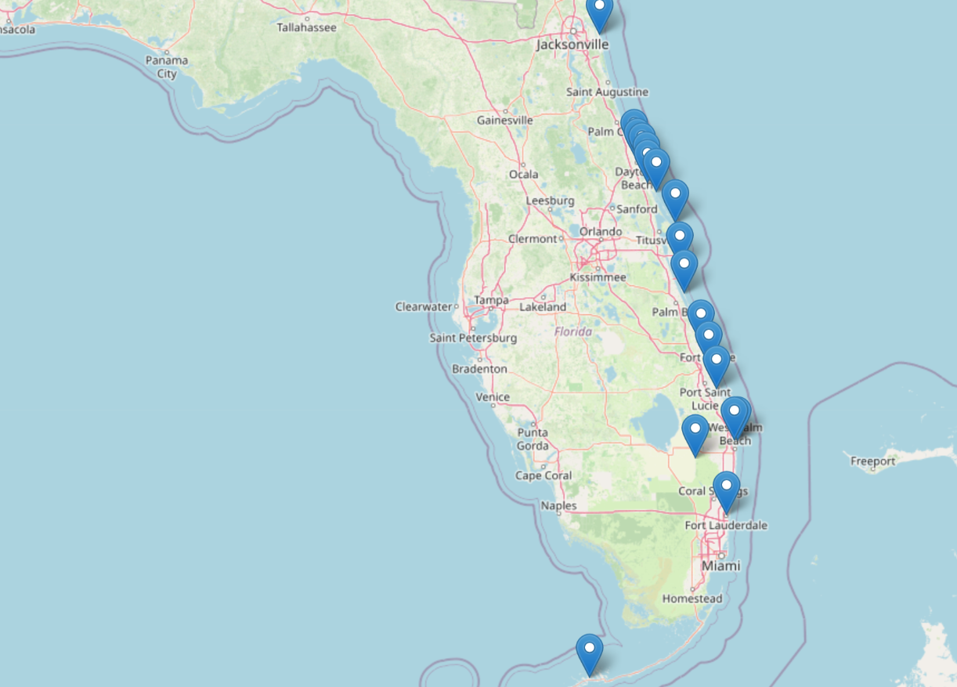
Hotspots for shark attacks
• Shark attacks are concentrated on the east coast along popular beach destinations
• New Smyrna Beach stands out as the most dangerous coast
• Set up early warning systems and patrols in high-risk zones

Slide 6
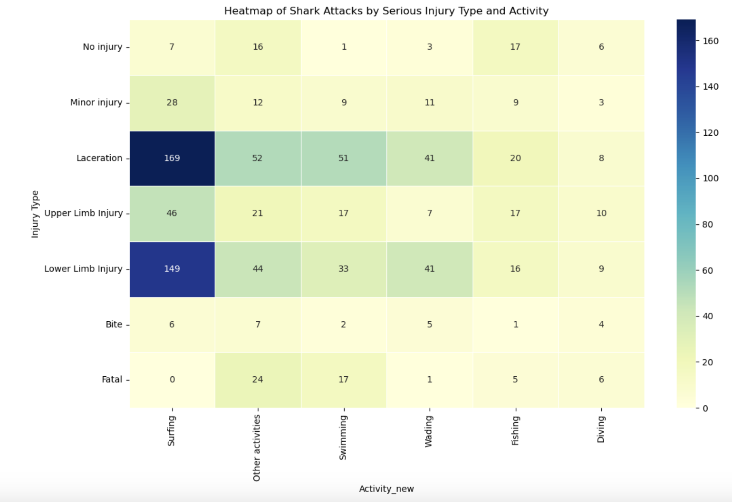
Surfing into danger!
• Trauma fatalities and lacerations are highest among surfers and swimmers
• Focus lifeguards around high-risk activity spots and equip staff with appropriate supplies and training

Slide 7
Charting the course: Methods
• Python functions/libraries used:
Panda, Regex, Matplot, list comprehension, conditional statements, and others
• The data analysis process included:
Research and hypotheses
Filtering
Formatting
Categorization
Removal of duplicates
Descriptive statistics
Correlations
Plots

Slide 8
Exploring key relationships
Several additional relationships are yet to be explored and will provide additional valuable insights to the Florida lifeguards team:
Valuable 1 | Valuable 2 | P-value | Cramer’s value | Interpretation
Location | Activity | 1.47e-32 | 0.45 | Strong association with a significant relationship
Location | Season | 8.42e-04 | 0.36 | Strong association with a significant relationship
Location | Time of Day | 2.42e-12 | 0.39 | Strong association with a significant relationship
Activity | Season | 3.33e-05 | 0.16 | Moderate association with a significant relationship
Activity | Time of Day | 2.21e-09 | 0.18 | Moderate association with a significant relationship
Season | Time of Day | 4.78e-01 | 0.08 | Weak association with no significant relationship

Slide 9

Rough waters: Major Obstacles
• Data quality issues: Inconsistent and ambiguous data required significant cleaning efforts and learning (googling) new techniques
• Data visualization challenges: Limited options available, with most variables being categorical
• Developing a codebook (.py): Importing function codes from the codebook required additional time to guarantee successful operation

Slide 10

Thank You
Lifeguard Response Strategies: Analyzing Shark Attack Trends in Florida
Prepared by: Nancy, Aru, Benoit, Diego

